Slide 1
랩미팅

Slide 2
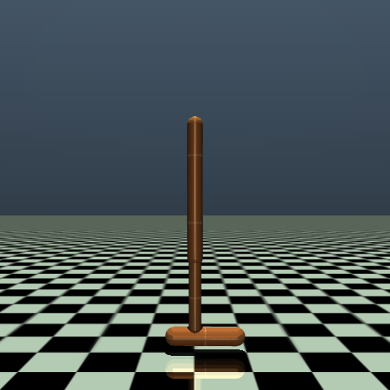
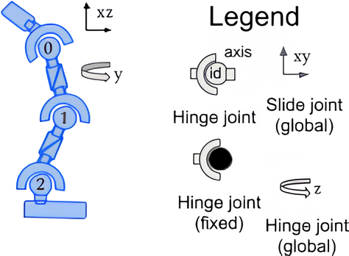


Hopper
$$z$$
$$x$$
Observation
nominal
residual
Index | Observation | Mean | Range
0 | root_z | z-coordinate of the torso (height of hopper) | -[inf, inf]
1 | root_y | angle of the torso | -[inf, inf]
2 | thigh_joint | angle of the thigh joint | -[inf, inf]
3 | leg_joint | angle of the leg joint | -[inf, inf]
4 | foot_joint | angle of the foot joint | -[inf, inf]
5 | root_vx | velocity of the x-coordinate of the torso | -[inf, inf]
6 | root_vz | velocity of the z-coordinate of the torso | -[inf, inf]
7 | root_vy | angular velocity of the angle of the torso | -[inf, inf]
8 | thigh_joint_v | angular velocity of the thigh hinge | -[inf, inf]
9 | leg_joint_v | angular velocity of the leg hinge | -[inf, inf]
10 | foot_joint_v | angular velocity of the foot hinge | -[inf, inf]
슬라이드 2에서 정의된 가동 범위의 값만 들어옴
Torso
0: Thigh joint
Thigh
1: Leg joint
실제 코드에서는 [–10, 10]으로 clipping
Leg
2: Foot joint
Foot

Slide 3

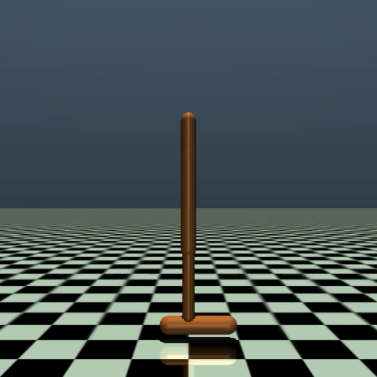
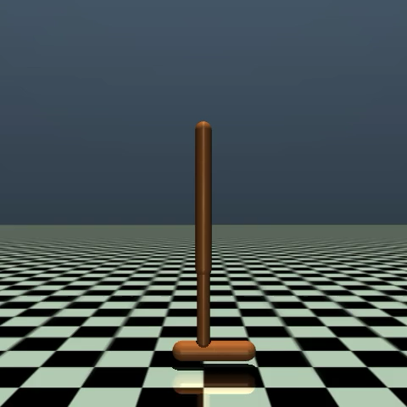

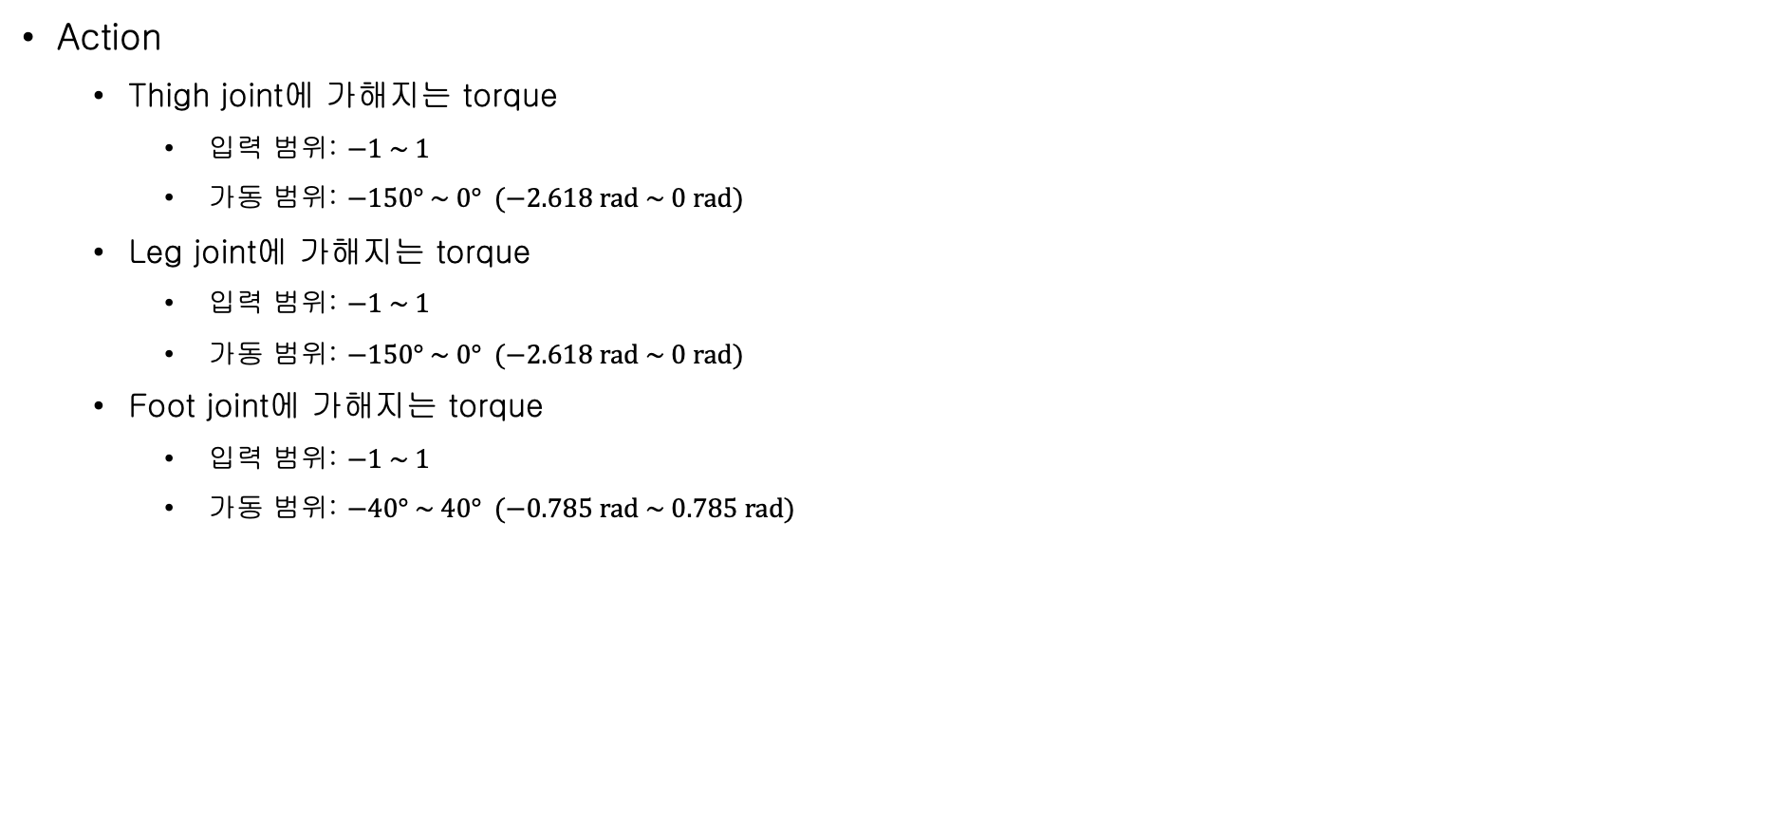
Hopper
Torso
0: Thigh joint
Thigh
Action
  Thigh joint에 가해지는 torque
    입력 범위: $−1 \sim 1$
    가동 범위: $−150° \sim 0° (−2.618 rad \sim 0 rad)$
  Leg joint에 가해지는 torque
    입력 범위: $−1 \sim 1$
    가동 범위: $−150° \sim 0° (−2.618 rad \sim 0 rad)$
  Foot joint에 가해지는 torque
    입력 범위: $−1 \sim 1$
    가동 범위: $−40° \sim 40° (−0.785 rad \sim 0.785 rad)$
1: Leg joint
Leg
2: Foot joint
Foot
action 입력: 설정된 gear 값(200)을 곱해 torque를 계산 -> MuJoCo 시뮬레이션에 적용
각가속도 계산: forward dynamics 계산을 통해 각가속도 계산
각속도 계산: Semi-implicit Euler + 4th-order Runge-Kutta
초기 상태: 모든 joint의 제어 입력이 0
다른 joint들의 제어 입력은 모두 0으로 고정한 상태로 실험 joint의 제어 입력을 -1로 설정
이후 다시 +1로 설정
Thigh joint
Leg joint
Foot joint

Slide 4
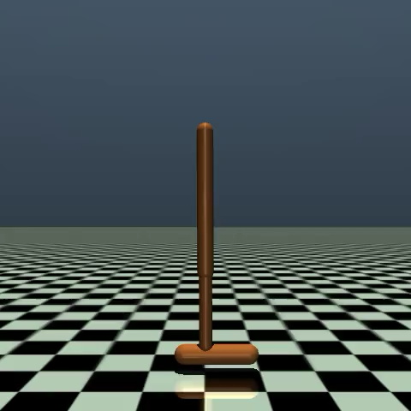
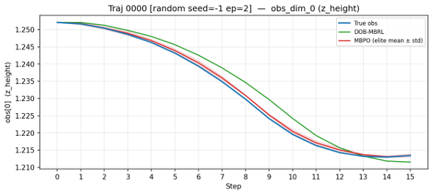
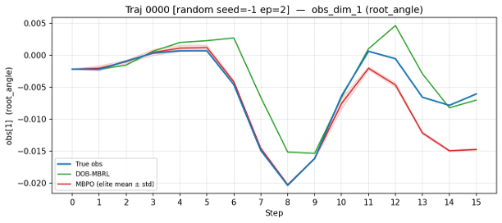
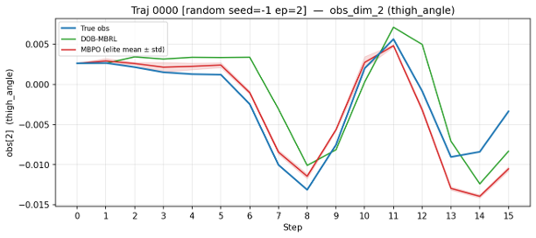
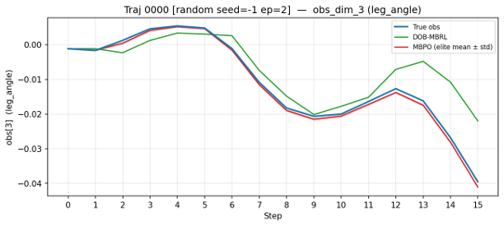
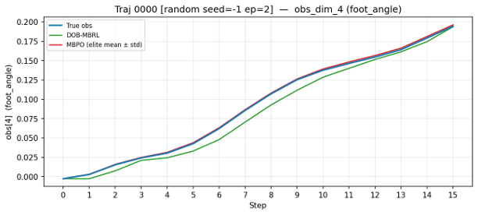
Trajectory 0
nominal
residual
video
0: z-coordinate of the torso
1: angle of the torso
2: angle of the thigh joint
3: angle of the leg joint
4: angle of the foot joint

Slide 5
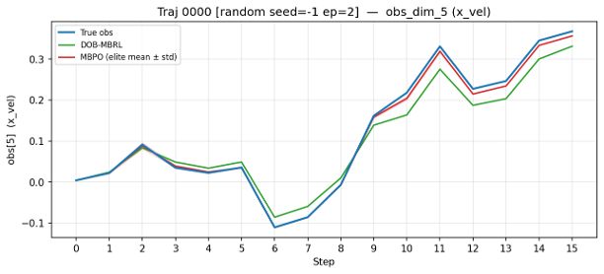
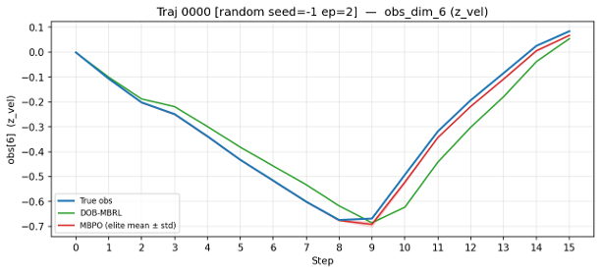
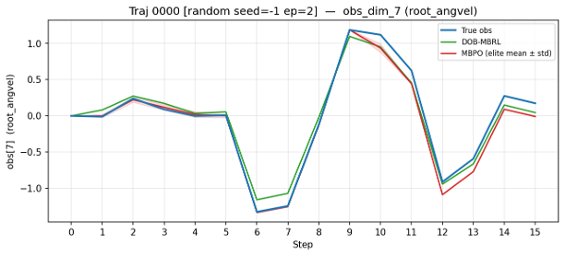
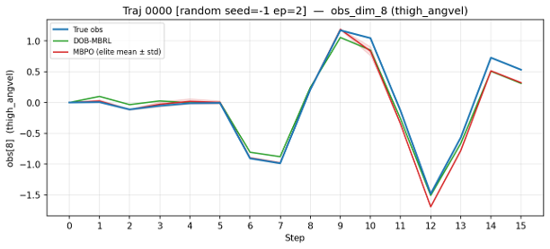
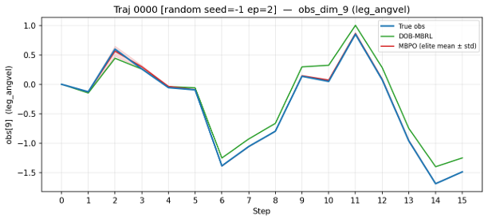
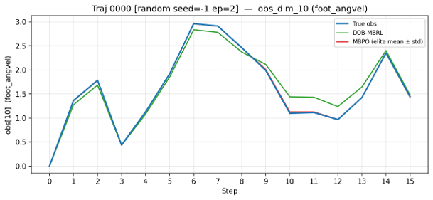
Trajectory 0
nominal
residual
5: velocity of the x-coordinate of the torso
6: velocity of the z-coordinate of the torso
7: angular velocity of the angle of the torso
8: angular velocity of the thigh hinge
9: angular velocity of the leg hinge
10: angular velocity of the foot hinge

Slide 6
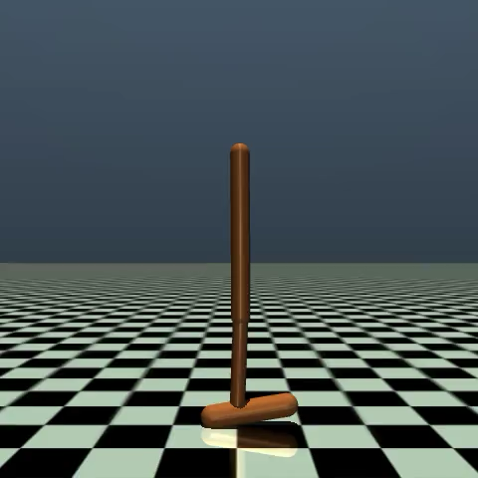
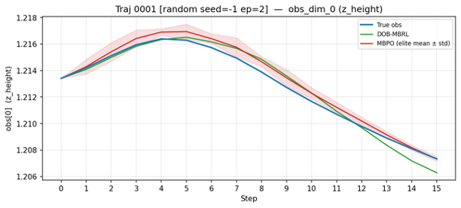
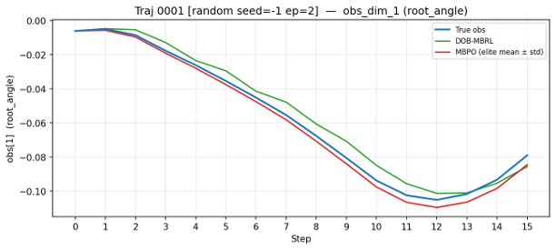
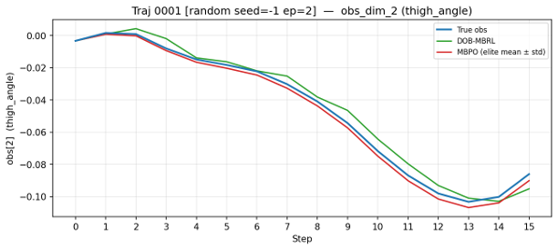
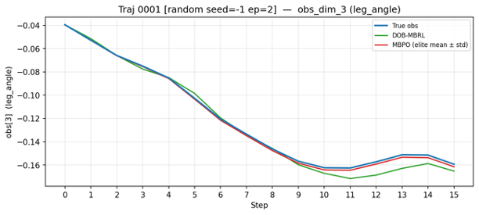
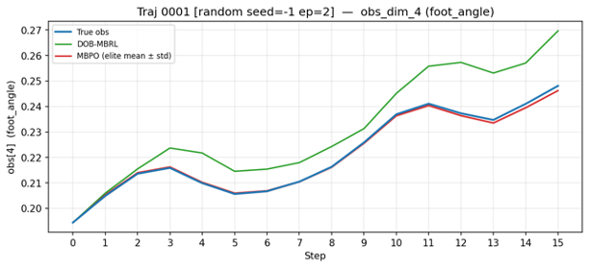
Trajectory 1
nominal
residual
video
0: z-coordinate of the torso
1: angle of the torso
2: angle of the thigh joint
3: angle of the leg joint
4: angle of the foot joint

Slide 7
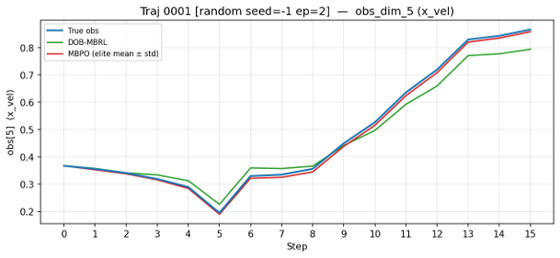
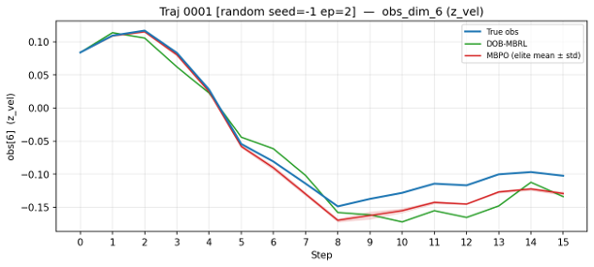
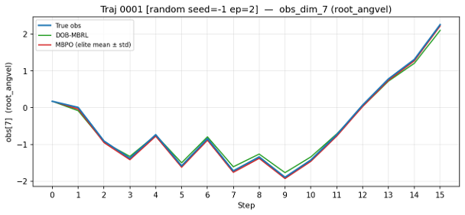
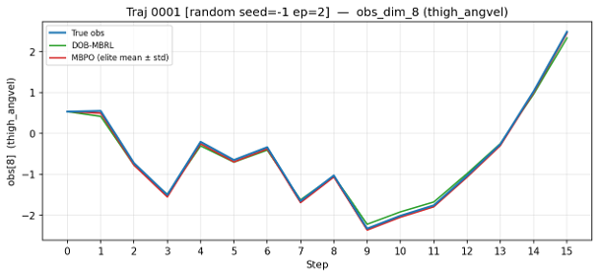
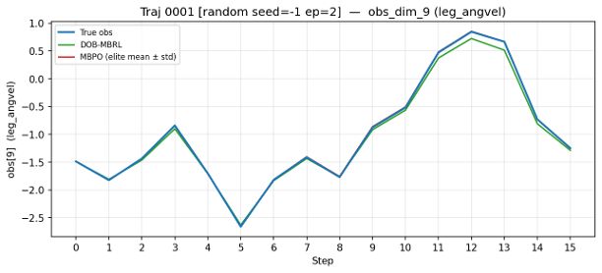
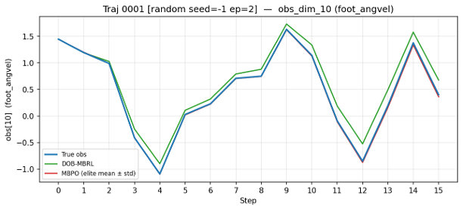
Trajectory 1
nominal
residual
5: velocity of the x-coordinate of the torso
6: velocity of the z-coordinate of the torso
7: angular velocity of the angle of the torso
8: angular velocity of the thigh hinge
9: angular velocity of the leg hinge
10: angular velocity of the foot hinge

Slide 8
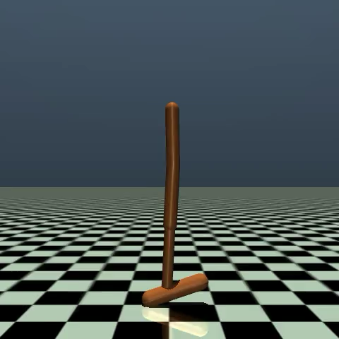
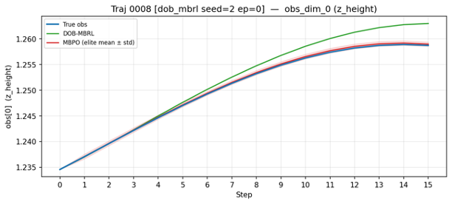
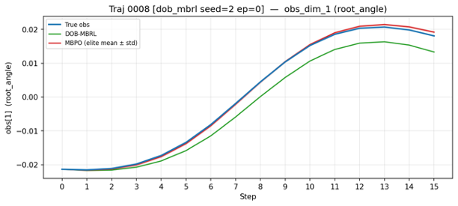
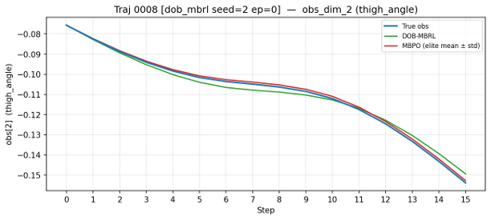
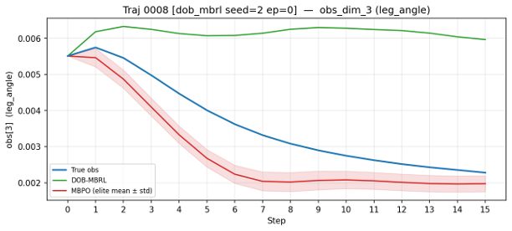
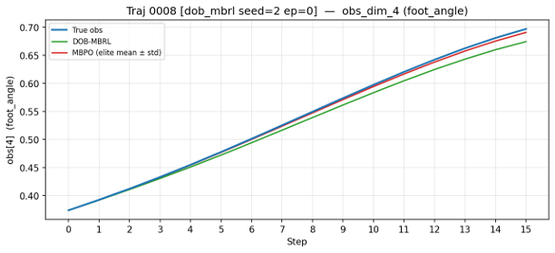
Trajectory 8
nominal
residual
video
0: z-coordinate of the torso
1: angle of the torso
2: angle of the thigh joint
3: angle of the leg joint
4: angle of the foot joint

Slide 9
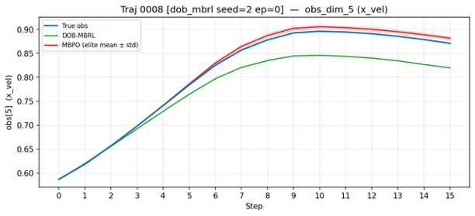
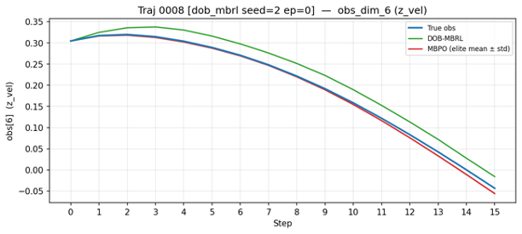
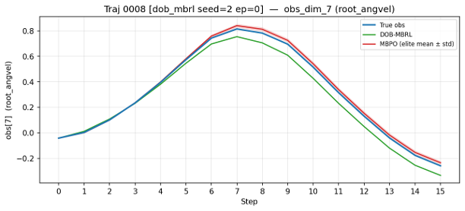
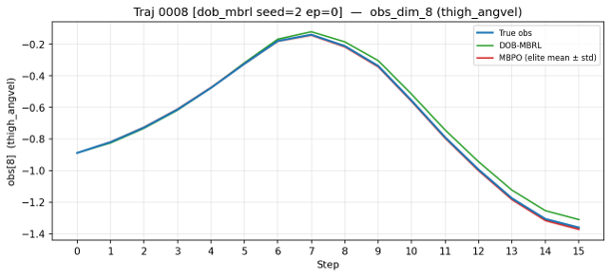
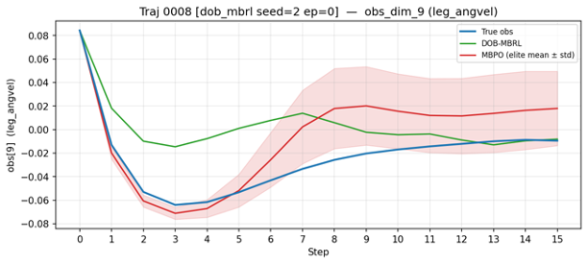
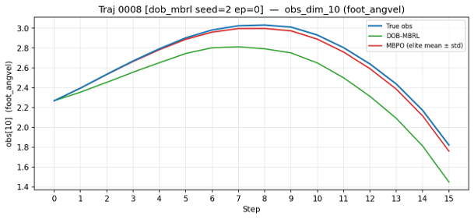
Trajectory 8
nominal
residual
5: velocity of the x-coordinate of the torso
6: velocity of the z-coordinate of the torso
7: angular velocity of the angle of the torso
8: angular velocity of the thigh hinge
9: angular velocity of the leg hinge
10: angular velocity of the foot hinge

Slide 10
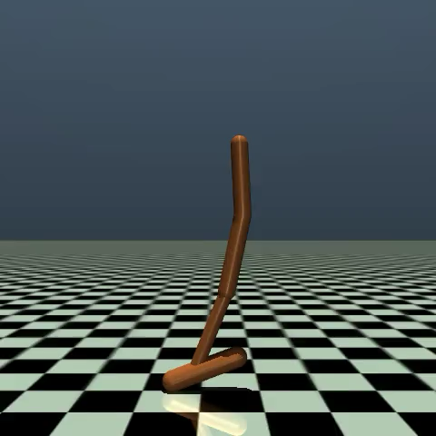
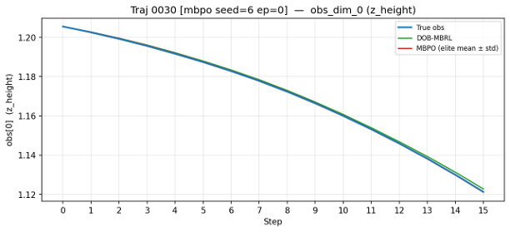
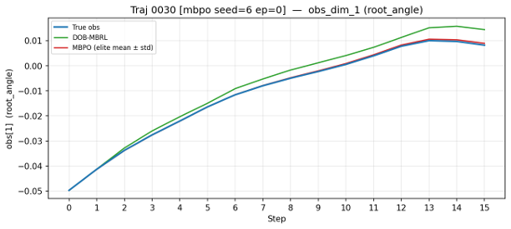
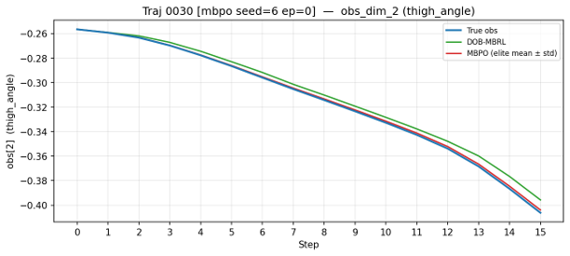
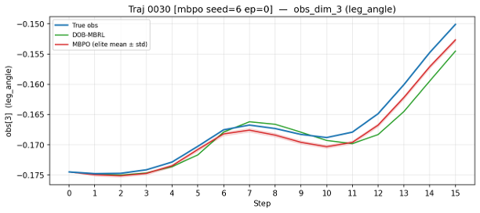
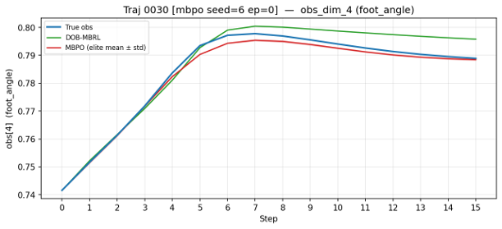
Trajectory 30
nominal
residual
video
0: z-coordinate of the torso
1: angle of the torso
2: angle of the thigh joint
3: angle of the leg joint
4: angle of the foot joint

Slide 11
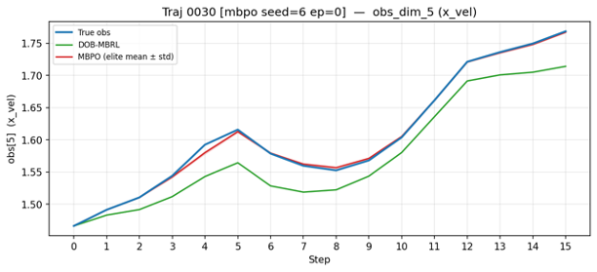
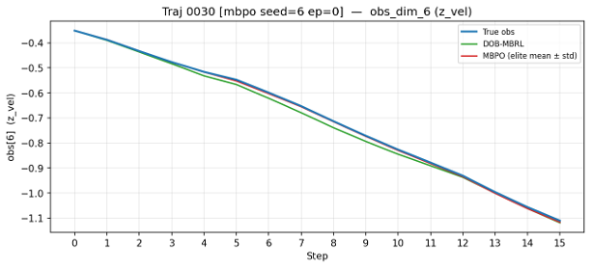
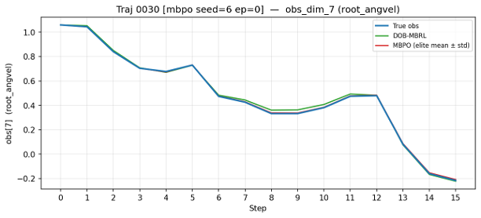



Trajectory 30
nominal
residual
5: velocity of the x-coordinate of the torso
6: velocity of the z-coordinate of the torso
7: angular velocity of the angle of the torso
8: angular velocity of the thigh hinge
9: angular velocity of the leg hinge
10: angular velocity of the foot hinge

Slide 12



결론
현재 rollout 방식에 따르면 nominal model은 residual model로부터 보정된 이전 step의 observation으로부터 Euler 적분으로 계산
따라서 실제보다 오차가 지연돼서 반영
그러다보니 5D 차원의 오차가 계속 누적되고, 이 부분이 다시 residual model 입력으로 들어가게 되니까 6D 차원의 model 예측도 망가짐
action에 의해 이미 각속도가 바뀌었고 이 바뀐 각속도를 가지고 Euler 적분을 해야 정확한 5D obs 추정 가능
실제 데이터
rollout
$$t=1$$
$$t=2$$
$$t=3$$
5D obs
5D obs
5D obs
6D obs
6D obs
6D obs
+
+
Residual Model (MLP)
Residual Model (MLP)
observation
nominal
residual

Slide 13
제가 실수했던 부분이 있었습니다..
Observation
nominal
residual
Index | Observation | Mean | Range
0 | root_z | z-coordinate of the torso (height of hopper) | -[inf, inf]
1 | root_y | angle of the torso | -[inf, inf]
2 | thigh_joint | angle of the thigh joint | -[inf, inf]
3 | leg_joint | angle of the leg joint | -[inf, inf]
4 | foot_joint | angle of the foot joint | -[inf, inf]
5 | root_vx | velocity of the x-coordinate of the torso | -[inf, inf]
6 | root_vz | velocity of the z-coordinate of the torso | -[inf, inf]
7 | root_vy | angular velocity of the angle of the torso | -[inf, inf]
8 | thigh_joint_v | angular velocity of the thigh hinge | -[inf, inf]
9 | leg_joint_v | angular velocity of the leg hinge | -[inf, inf]
10 | foot_joint_v | angular velocity of the foot hinge | -[inf, inf]
이전에 보여드렸던 결과 (다음 슬라이드 참조)가 residual model 이 아래 6개만 학습한 결과가 아니라, residual model이 전체 observation에 대해 학습된 결과였습니다..

Slide 14






제가 실수했던 부분이 있었습니다..
이전에 보여드린 결과
실제 결과
return
model error
rollout horizon

Slide 15



6D vs 11D residual model
return
model error
rollout horizon

